Slide 1
Seminário: Em busca do desenvolvimento perdido
Roberto Ellery Jr, ECO/FACE/UnB

Slide 2
Desindustrialização e má alocação de capital
Queda na participação da indústria no PIB
Indústria e produtividade
Má alocação de capital

Slide 3
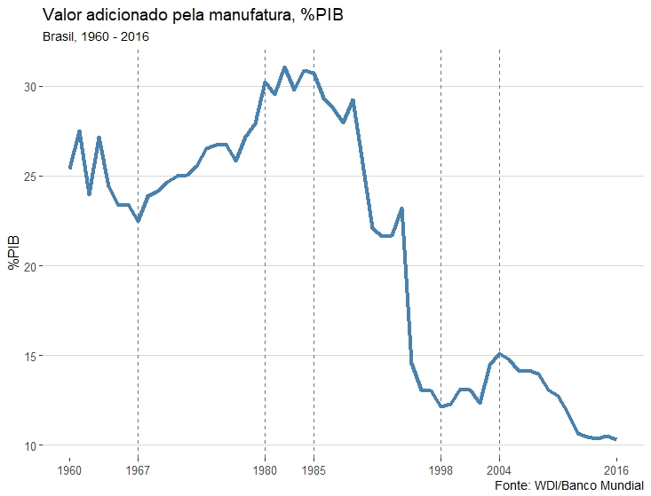
Queda na participação da indústria no PIB

Slide 4
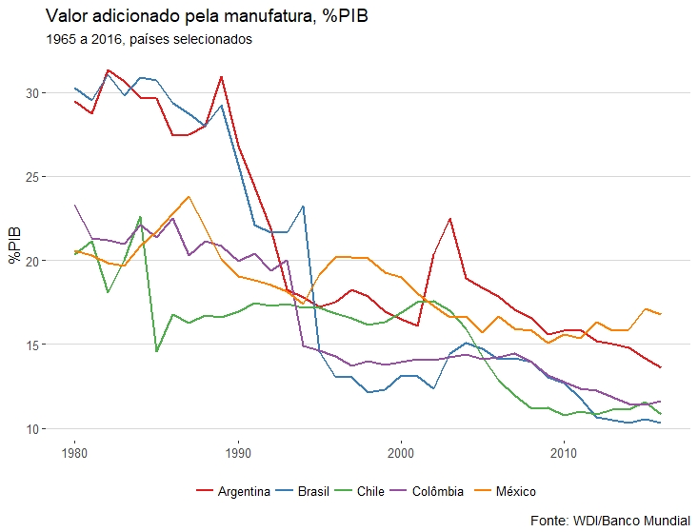
Queda na participação da indústria no PIB

Slide 5
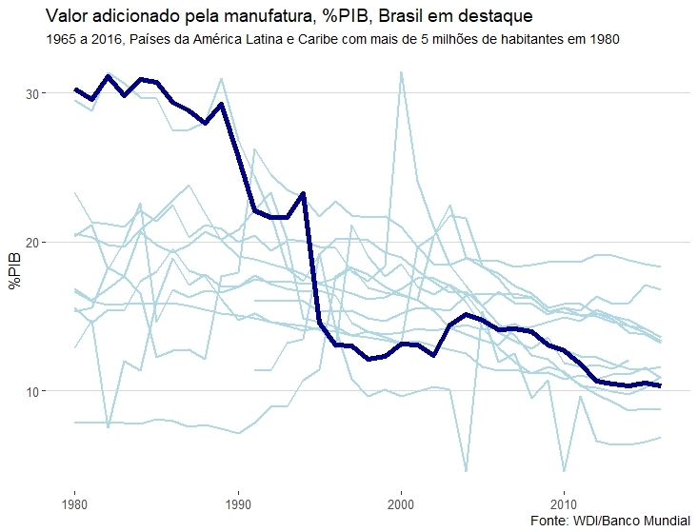
Queda na participação da indústria no PIB

Slide 6
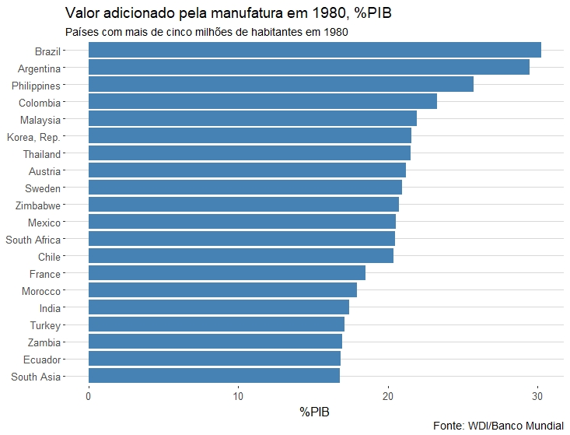
Queda na participação da indústria no PIB

Slide 7
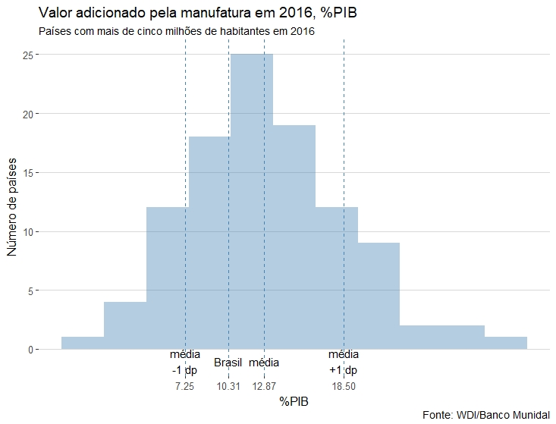
Queda na participação da indústria no PIB

Slide 8
Queda na participação da indústria no PIB
Os dados analisados sugerem que em 1980 a participação da manufatura do PIB era muito alta se considerados padrões internacionais.
Hoje a participação da manufatura do PIB no Brasil é um pouco abaixo da média dos países analisados e dos países da América Latina e Caribe.
A forte redução da participação da manufatura do PIB que ocorreu no Brasil (e na Argentina) pode ser uma “volta ao normal”.

Slide 9
Indústria e produtividade
O Brasil em Comparações Internacionais de Produtividade: Uma Análise Setorial. Fernando Veloso, Silvia Matos, Pedro Cavalcanti Ferreira e Bernardo Coelho. Em: Anatomia da Produtividade no Brasil. Regis Bonelli, Fernando Veloso e Armando Castelar Pinheiro (org). Elsevier.
  Socio Economic Accounts (SEA).
    World Input-Output Database (WIOD)
    70% da SEA são países europeus
  World Table (PWT), versão 8.1, para PPP agregada
  Dados de PPP para o setor de serviços do Groningen Growth and Development Centre Productivity Level Database

Slide 10
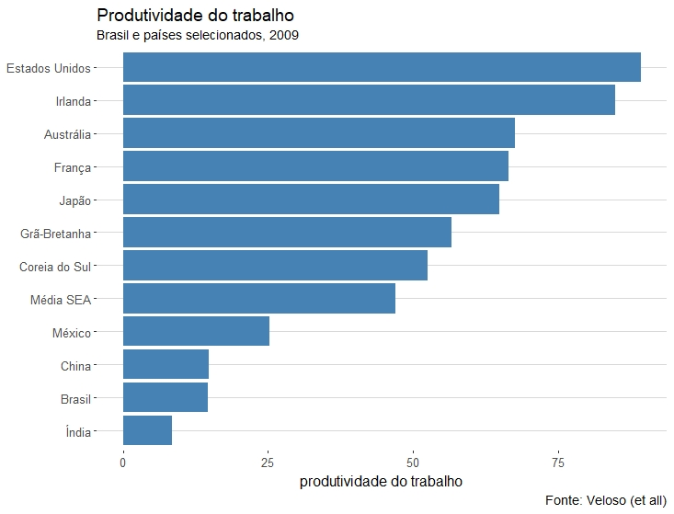
Indústria e produtividade

Slide 11
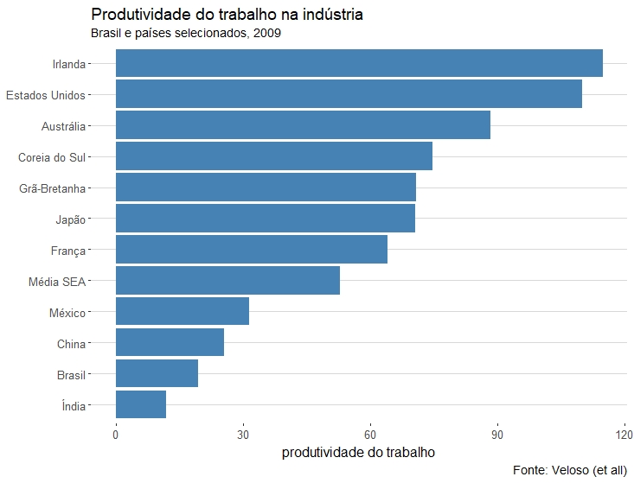
Indústria e produtividade

Slide 12
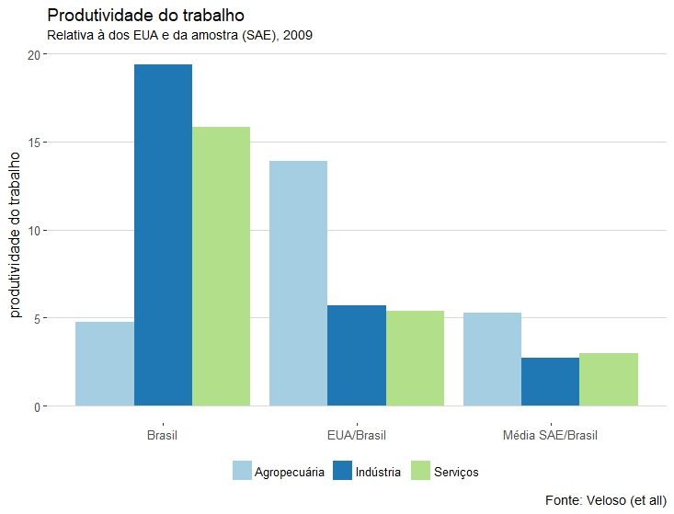
Indústria e produtividade

Slide 13
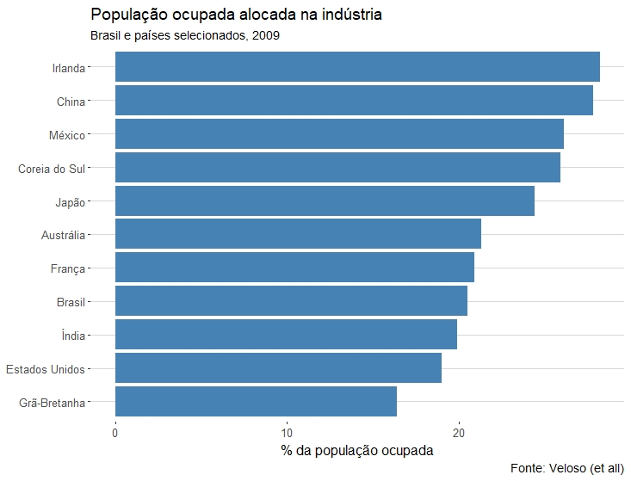
Indústria e produtividade

Slide 14
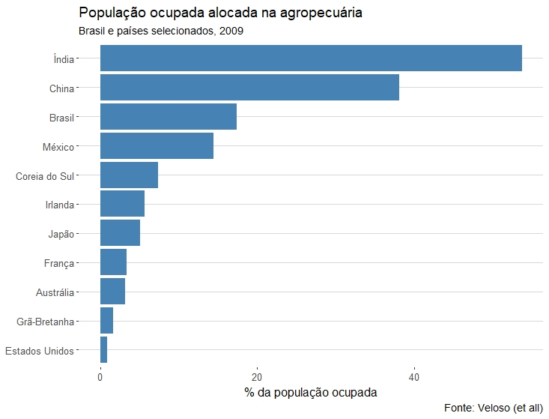
Indústria e produtividade

Slide 15
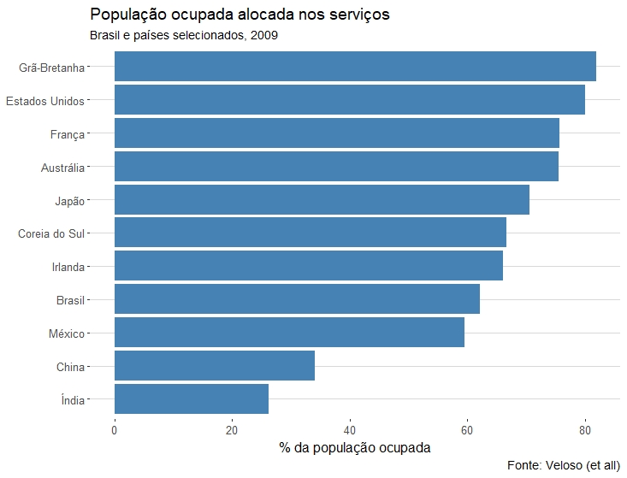
Indústria e produtividade

Slide 16
Indústria e produtividade
“A análise revela que, embora a produtividade do Brasil possa aumentar se nossa alocação setorial de trabalho se aproximar da observada nos países desenvolvidos, os ganhos potenciais são muito maiores caso nossa produtividade setorial convirja para o nível observado nessas economias.”

Slide 17
Indústria e produtividade
The Textbook Case for Industrial Policy: Theory Meets Data. Dominick Bartelme, Arnaud Costinot, Dave Donaldson, Andres Rodriguez-Clare. Agosto, 2019.
  The textbook case for industrial policy is well understood. In sectors subject to external economies of scale, private marginal costs of production are lower than social ones. This creates a rationale for Pigouvian subsidies equal to the difference between the two, with the associated welfare gains equal to the area of the Harberger triangle located between the demand and social marginal cost curves.
  (…)
  A major source of skepticism about industrial policy is that governments simply do not know which sectors should be subsidized at the expense of others. In this paper, we have focused on the textbook case for industrial policy, in which the rationale for such policy arises from the existence of external economies of scale; we have shown how, in this environment, one can use commonly available trade and production data to estimate economies of scale at the sector-level; and, in turn, we have characterized the structure and consequences of optimal industrial policy.
  Our baseline results are humbling. Empirically, we find that sector-level economies of scale indeed exist and do differ substantially across sectors, ranging from an elasticity of 0.07 to 0.25. Yet, even under our optimistic assumption that governments maximize welfare and have full knowledge of the underlying economy, our baseline analysis points towards gains from optimal industrial policy that are, on average across all countries, equal to just 0.69% of GDP, and only amount to 1.36% for the country that gains the most. These modest gains from industrial policy are slightly smaller than the average gains from optimal trade policy alone, which are equal to 0.95% of GDP.

Slide 18
Má alocação de capital
“Studying the experience of countries that have experienced great depressions during the 20th century teaches us that massive public interventions in the economy to maintain employment and investment during a financial crisis can, if they distort incentives enough, lead to a great depression. Those who try to justify the sorts of Keynesian policies implemented by the Mexican government in the 1980s and the Japanese government in the 1990s often quote Keynes’ (1924) dictum from A Tract on Monetary Reform: “The long run is a misleading guide to current affairs. In the long run we are all dead.” Studying past great depressions turns this dictum on its head: “If we do not consider the consequences of policy for productivity, in the long run we could all be in a great depression.””
  Timothy Kehoe e Gonzalo Fernández de Córdoba

Slide 19
Má alocação de capital
Policy distortions and aggregate productivity with heterogeneous establishments. Diego Restuccia e Richard Rogerson. Review of Economic Dynamics, 2008.
  “We formulate a version of the growth model in which production is carried out by heterogeneous establishments and calibrate it to US data. In the context of this model we argue that differences in the allocation of resources across establishments that differ in productivity may be an important factor in accounting for cross-country differences in output per capita. In particular, we show that policies which create heterogeneity in the prices faced by individual producers can lead to sizeable decreases in output and measured total factor productivity (TFP) in the range of 30 to 50 percent. We show that these effects can result from policies that do not rely on aggregate capital accumulation or aggregate relative price differences. More generally, the model can be used to generate differences in capital accumulation, relative prices, and measured TFP.”

Slide 20
Má alocação de capital
Misallocation and manufacturing TFP in China and India. Chang-Tai Hsieh e Peter Klenow. Quarterly Journal of Economics, 2009.
  Resource misallocation can lower aggregate total factor productivity (TFP). We use microdata on manufacturing establishments to quantify the potential extent of misallocation in China and India versus the United States. We measure sizable gaps in marginal products of labor and capital across plants within narrowly defined industries in China and India compared with the United States. When capital and labor are hypothetically reallocated to equalize marginal products to the extent observed in the United States, we calculate manufacturing TFP gains of 30%–50% in China and 40%–60% in India.

Slide 21
Má alocação de capital
Misallocation and manufacturing TFP in China and India. Chang-Tai Hsieh e Peter Klenow. Quarterly Journal of Economics, 2009.
  “For example, imagine an economy with two firms that have identical technologies but in which the firm with political connections benefits from subsidized credit (say from a state-owned bank) and the other firm (without political connections) can only borrow at high interest rates from informal financial markets. Assuming that both firms equate the marginal product of capital with the interest rate, the marginal product of capital of the firm with access to subsidized credit will be lower than the marginal product of the firm that only has access to informal financial markets. This is a clear case of capital misallocation: aggregate output would be higher if capital was reallocated from the firm with a low marginal product to the firm with a high marginal product. The misallocation of capital results in low aggregate output per worker and TFP.”

Slide 22
Má alocação de capital
Misallocation and manufacturing TFP in China and India. Chang-Tai Hsieh e Peter Klenow. Quarterly Journal of Economics, 2009.
  “Many institutions and policies can potentially result in resource misallocation. For example, the McKinsey Global Institute (1998) argues that a key factor behind low productivity in Brazil’s retail sector is labor-market regulations driving up the cost of labor for supermarkets relative to informal retailers. Despite their low productivity, the lower cost of labor faced by informal-sector retailers makes it possible for them to command a large share of the Brazilian retail sector. Lewis (2004) describes many similar case studies from the McKinsey Global Institute.”

Slide 23
Má alocação de capital
Misallocation and manufacturing TFP in China and India. Chang-Tai Hsieh e Peter Klenow. Quarterly Journal of Economics, 2009.
  In this section we relate TFPR dispersion in China to state ownership of plants, and TFPR dispersion in India to licensing and size restrictions.
  Na China os autores encontram relação entre empresas estatais (menos produtivas) e a dispersão da produtividade, essa relação desaparece em 2005 em parte por conta da redução da importância das estatais (29% em 1998 e 8% em 2005) e em parte pelo aumento da produtividade das estatais sobreviventes.
  Na Índia os autores encontram relação entre dispersão de produtividade e regras de licenciamento e limites de tamanho para empresas.

Slide 24
Má alocação de capital
Misallocation in the Brazilian manufacturing sector, Rafael Vasconcelos, Brazilian Review of Econometrics, v.37, n.2, 2017.
  According to this figure, the misallocation falls between 1996 and 2005 and then tends to grow. This pattern is observed in both specifications. In 2005, the lowest year of misallocation, the product is 44.7% farther from the product efficient when using U.S. Industry Share. When we use the Firm-Specific Share, this distance is 54.3%. Thus, an efficient reallocation in times of lower misallocation in the Brazilian manufacturing sector will result in the approximately doubling of the aggregate product. This effect was even greater after 2005.

Slide 25
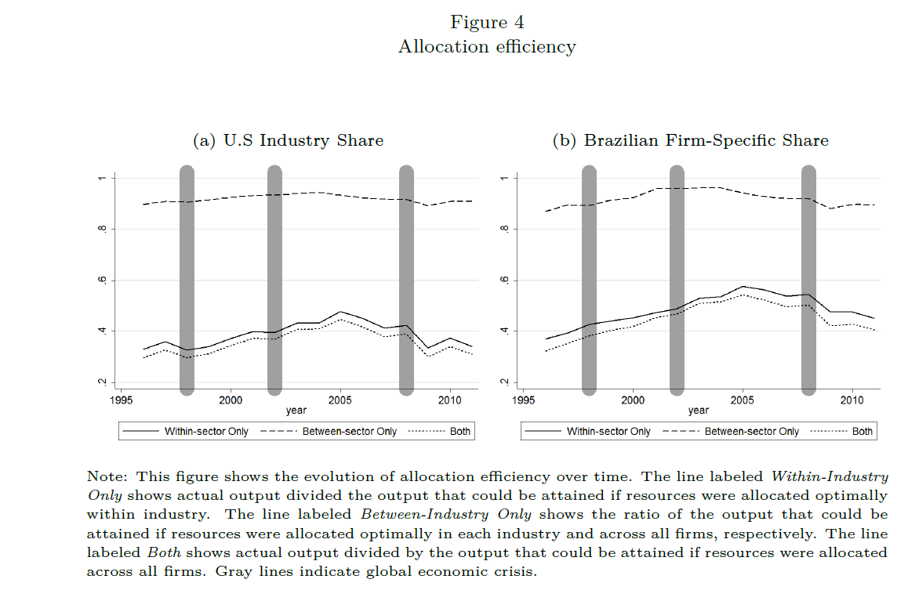
Má alocação de capital

Slide 26
Má alocação de capital
Rafaela Bastidas & Nicolás Acosta, 2019. "Misallocation and manufacturing TFP in Ecuador: formal, semi-formal and informal firms," Journal of Economic Structures, Springer;Pan-Pacific Association of Input-Output Studies (PAPAIOS), vol. 8(1), pages 1-29, December.
Laiqun Jin & Changwei Mo & Bochao Zhang & Bing Yu, 2018. "What Is the Focus of Structural Reform in China?—Comparison of the Factor Misallocation Degree within the Manufacturing Industry with a Unified Model," Sustainability, MDPI, Open Access Journal, vol. 10(11), pages 1-19, November.
Wu, Guiying Laura, 2018. "Capital misallocation in China: Financial frictions or policy distortions?," Journal of Development Economics, Elsevier, vol. 130(C), pages 203-223.
Doan Thi Thanh Ha & Kozo Kiyota, 2015. "Misallocation, Productivity, and Trade Liberalization: The Case of Vietnamese Manufacturing," Keio-IES Discussion Paper Series 2015-007, Institute for Economics Studies, Keio University.
Sangeeta Pratap & Carlos Urrutia & Felipe Meza, 2014. "Credit, Misallocation and TFP: The case of Mexico (2003-2010)," 2014 Meeting Papers 701, Society for Economic Dynamics.
D׳Erasmo, Pablo N. & Moscoso Boedo, Hernan J. & Şenkal, Aslı, 2014. "Misallocation, informality, and human capital: Understanding the role of institutions," Journal of Economic Dynamics and Control, Elsevier, vol. 42(C), pages 122-142.
Ezra Oberfield, 2013. "Productivity and Misallocation During a Crisis: Evidence from the Chilean Crisis of 1982," Review of Economic Dynamics, Elsevier for the Society for Economic Dynamics, vol. 16(1), pages 100-119, January.

Slide 27
Resumo
Ocorreu uma queda significativa na participação da indústria de transformação no PIB no Brasil desde 1980, é possível que esse movimento tenha sido um “retorno ao normal”.
Realocação setorial de mão de obra pode aumentar a produtividade do trabalho no Brasil, mas os efeitos dessa realocação são bem mais modestos do que melhorias na produtividade.
Não é fácil estabelecer relação de causalidade entre participação da indústria de manufatura no PIB e crescimento, mais difícil ainda é avaliar o impacto de políticas industriais no crescimento. Trabalho recente discutido na apresentação sugere que o efeito é modesto.
Má alocação de capital pode ter um papel significativo para explicar baixo desempenho da produtividade. No lugar de políticas de incentivos/subsídios/proteção a solução da má alocação de capital está mais relacionada com reformas.

Slide 28
Obrigado!
Roberto Ellery Jr
http://rgellery.blogspot.com.br/

